Slide 1



Detecting Fake Job Postings Using NLP and Machine Learning
Team Members:
Pranitha Anumolu (ZP32772)
Swetha Manchukonda (TA08134)
Professor:
Zeynep Kacar

Slide 2


Research Question:
How effective are machine learning models in detecting fake job postings, and what impact does their implementation have on job seekers' trust, application rates, and overall online job market security
Can natural language processing combined with machine learning effectively identify fake job postings to reduce fraud on freelancing platforms?

Slide 3
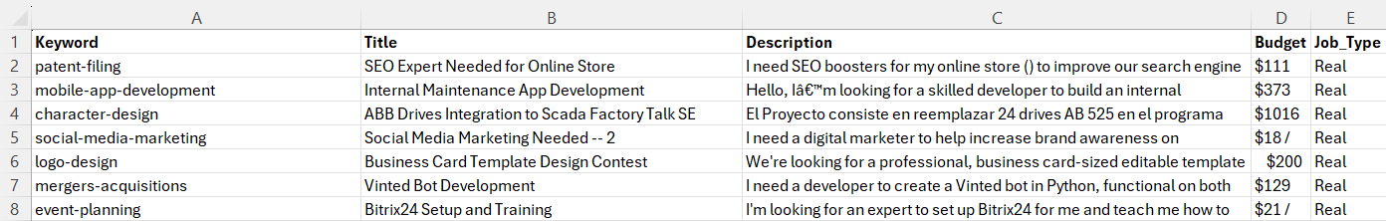
Dataset Description:
The dataset was web-scraped from freelancing platforms like Freelancer and Upwork.
It contains five main features: Keyword, Title, Description, Budget, and Job_Type.
There are a total of 15,000 job postings in the dataset.
Out of these, 10,000 are labeled as real jobs and 5,000 as fake jobs.

Slide 4
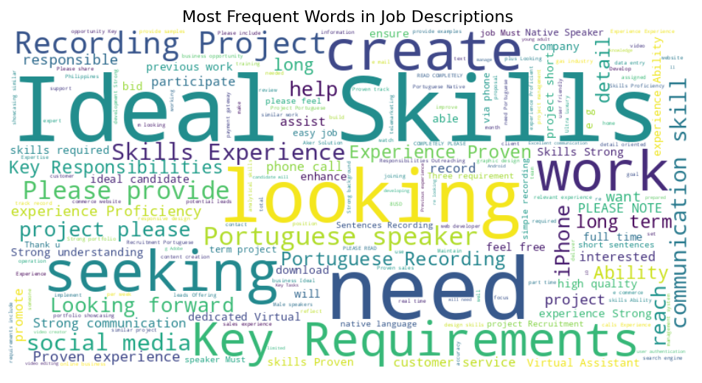
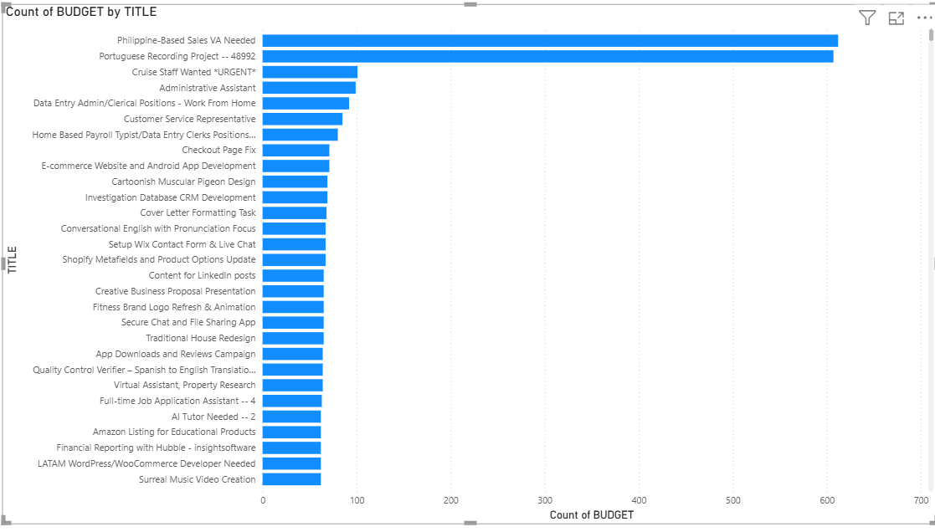
Exploratory Data Analysis:
Fake job descriptions commonly use vague or enticing words like “easy”, “quick”, and “money”. Real jobs focus on clear, skill-based terms like “developer”, “design”, and “project”.
Titles like “Portuguese Recording Project” appeared over 600 times, suggesting spam-like or template-based fake posts. Repetition in job titles helped us identify suspicious posting behavior.

Slide 5
Methodology
Logistic Regression: A baseline classifier to distinguish real vs. fake jobs using TF-IDF features.
Random Forest: Captures nonlinear relationships and interactions between textual features.
Naive Bayes: Efficient for text classification using probabilistic word distributions.
XGBoost: A powerful ensemble model used to boost performance on structured text features.

Slide 6
Assumptions Made
Job descriptions contain strong textual signals that help distinguish between real and fake job postings.
Vague or missing budget values are often associated with fake job listings.
A 2:1 imbalance in real vs. fake job data is acceptable for training reliable models.
The frequency and structure of words in descriptions vary significantly between real and fake jobs.

Slide 7
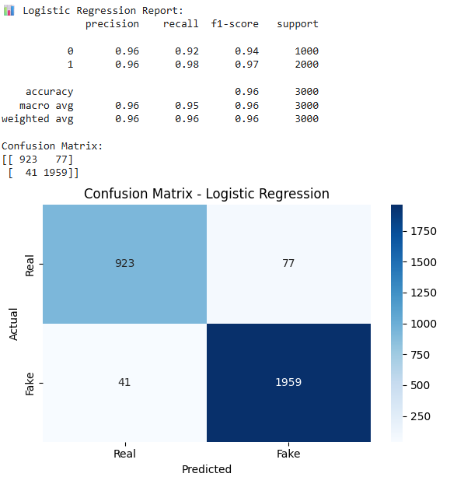
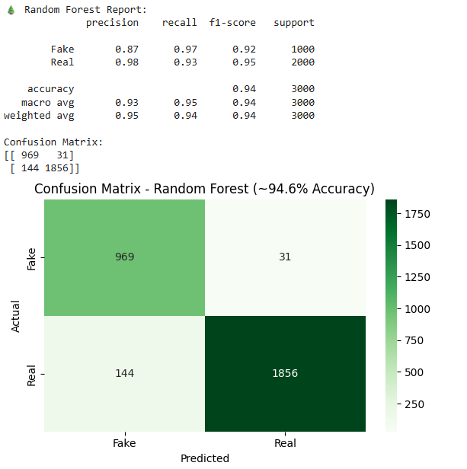
Results

Slide 8

Practical Implementation

Slide 9
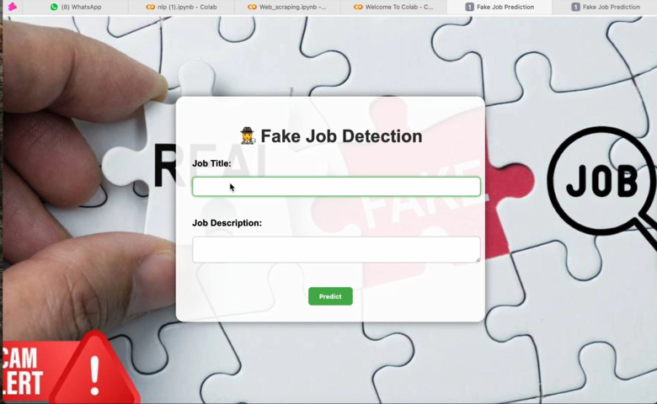
Demo

Slide 10
Key Points:
Built a user-friendly web interface to classify job postings as Real or Fake using trained machine learning models.
Users can input job title and description, and the system instantly predicts the authenticity of the posting.
Integrated Logistic Regression and Random Forest models in the backend for real-time predictions.
Applied TF-IDF vectorization to process job descriptions and convert them into model-ready features.
Deployed the model locally using Flask/Streamlit (or Google Colab) for demonstration purposes.
Designed the system to be lightweight, fast, and easy to integrate into real job platforms or browser extensions.

Slide 11
Conclusion
Random Forest and Logistic Regression models were successfully applied to detect fake job postings using job descriptions and budget features.
Random Forest performed better than Logistic Regression due to its ability to capture nonlinear patterns in the textual data.
Exploratory analysis revealed that fake jobs often had lower budgets, repetitive titles, and vague descriptions, helping the models differentiate effectively.
Text-based features alone were sufficient to achieve high accuracy, making this a lightweight but impactful approach for real-world deployment.

Slide 12
Limitations and Future Work
Only textual features and budget were used; excluding other factors like user profiles or post timing.
Collect more diverse data from multiple freelancing platforms to improve generalizability.
Integrate the model into a live web interface or job portal to automatically flag suspicious postings.
Enhance the model by incorporating metadata like employer ratings, posting frequency, or job duration.

